Slide 1
Using Block Ciphers

Slide 2
Review of PRF and PRP

Slide 3
PRF
Pseudo Random Function (PRF) defined over (K,X,Y):
F(K, X) ---> Y
such that exists “efficient” algorithm to evaluate F(k,x)

Slide 4
PRP
Pseudo Random Permutation (PRP) is a PRF along with the following properties:
1. Exists “efficient” deterministic algorithm to evaluate E(k,x)
2. The function E(k, x) is one-to-one
3. Exists “efficient” inversion algorithm D(k,x)

Slide 5
Secure PRF
A PRF with a fixed key K is said to be secure if it is indistinguishable from a randomly selected function from the entire space.
For example:
No.of PRF functions for AES =(2^128)^(2^128)
No.of PRF functions with fixed key; K = (2^128)

Slide 6
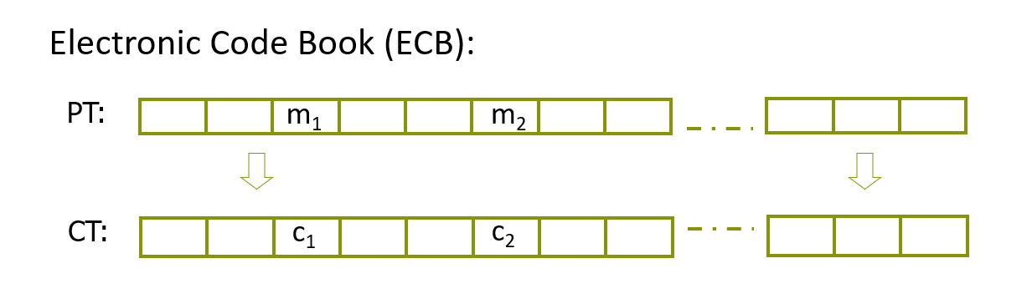
Incorrect use of PRP
If m1 = m2; then c1 = c2
Not secure

Slide 7
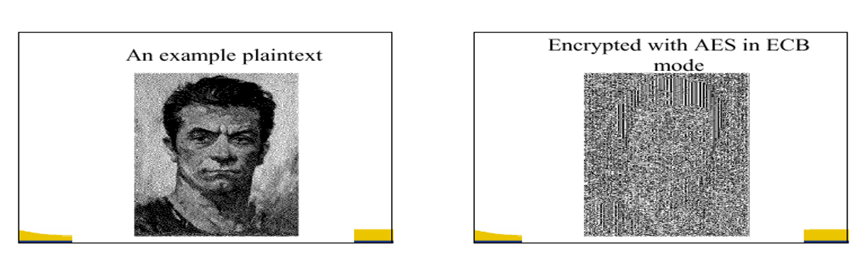

Slide 8
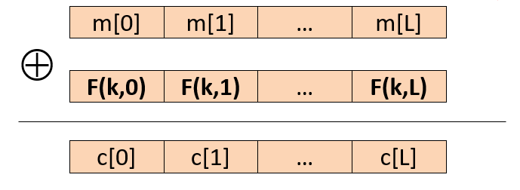
Deterministic Counter Mode
Pseudo Random Function (PRF) F(X,Y)
*This still isn’t secure as the output is always same for a message.

Slide 9
Semantic Security For Many-Time Key

Slide 10
It’s a game played by a Challenger, who claims to have a secure encryption method and an attacker who claims that the encryption is biased and can prove it by asking queries (providing inputs such as the plaintext) and the challenger replies with their cipher texts.

Slide 11
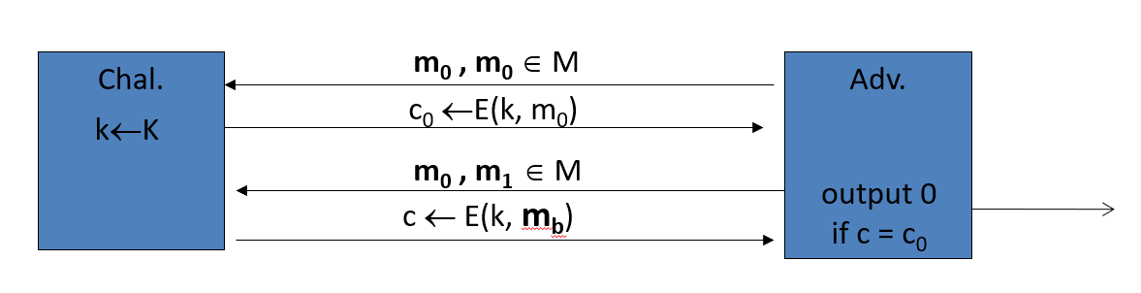
Chosen Plaintext Attack (CPA)
The attacker chooses (m0, m0) as his plain text for the first query
And then chooses (m0, m1) as his plain text for the second query.
The attacker can tell if the encryption given in the second query was of m0 or m1 because he already knows the encryption of m0 from his first query.
Notes:
Test does this work

Slide 12
To prevent CPA
We use
Randomized Encryption
Or
Nonce-based Encryption

Slide 13
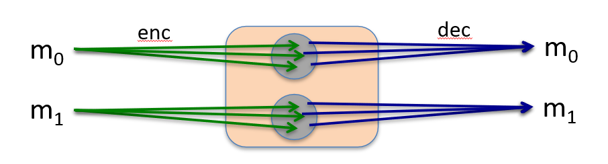
Randomized Encryption
Encrypting message gives different ciphertext
(length of ciphertext will be longer so it can map back to its message while decrypting)

Slide 14
Nonce-based Encryption

Slide 15
This encryption requires three inputs, the message, the secret key and the nonce which is a non-random but unique value

Slide 16
In brief the nonce modifies the secret key when passed through a PRF so that we have a unique key everytime we encrypt a block.

Slide 17
The nonce can be chosen randomly (with a large enough space to choose from to avoid repetitions) or can be treated as a counter (make sure it does not reset to 0 during the life of key)

Slide 18
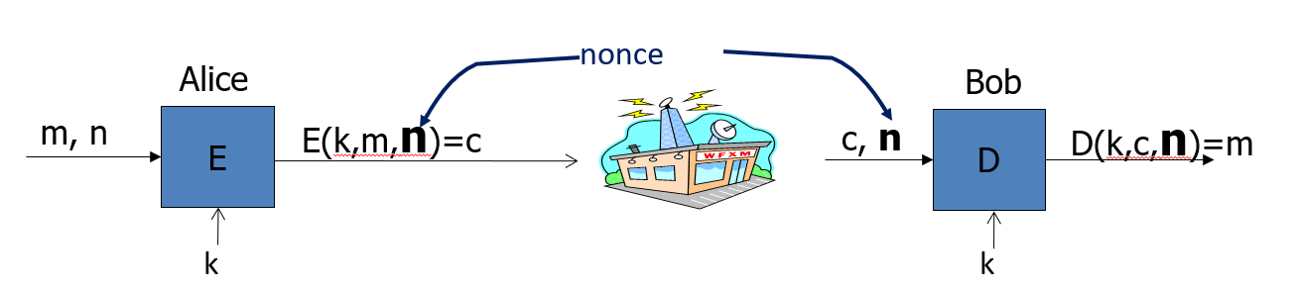

Slide 19
Building a
Cipher Block Chain
(CBC)

Slide 20
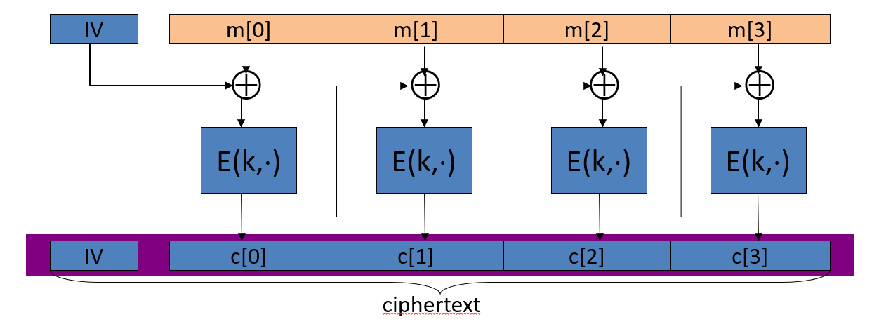
A random IV (Initial Vector) is chosen and XOR’ed with the message block and then encrypted to obtain a ciphertext. This ciphertext acts as the IV for the next block.
Finally, the IV is added to the ciphertext.
AES can encrypt at most 2^48 blocks using this method before the security is compromised (life of key)

Slide 21
Randomized
Counter-mode

Slide 22
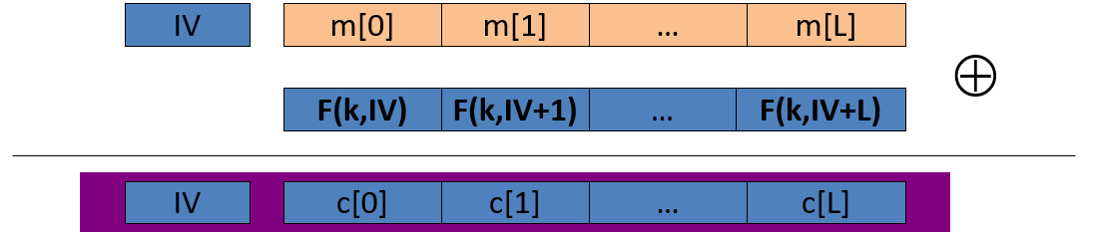
Here F(X,Y) is PRF.
A random IV (Initial Vector) is chosen for every message (not message block) and encrypted with the secret key and then XOR’ed with the message block.
For the next block, the IV increases by 1
*This way, each block is independent and allows parallel processing
AES can encrypt at most 2^64 blocks using this method before the security is compromised (life of key)

Slide 23
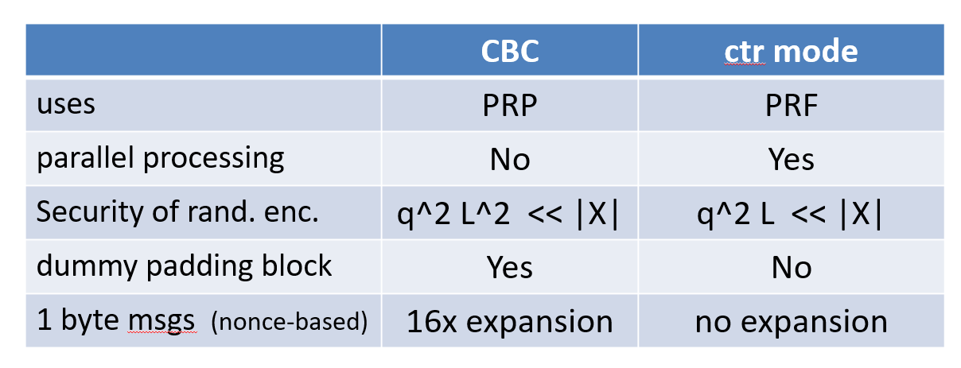
CBC vs Counter-mode
Counter mode is better

Slide 24
None of these
Provide Data
Integrity

